Slide 1
Texas A&M
College of Engineering
Engineering and Programming Foundations
Preparation for ENGR 102 – section 556

Slide 2
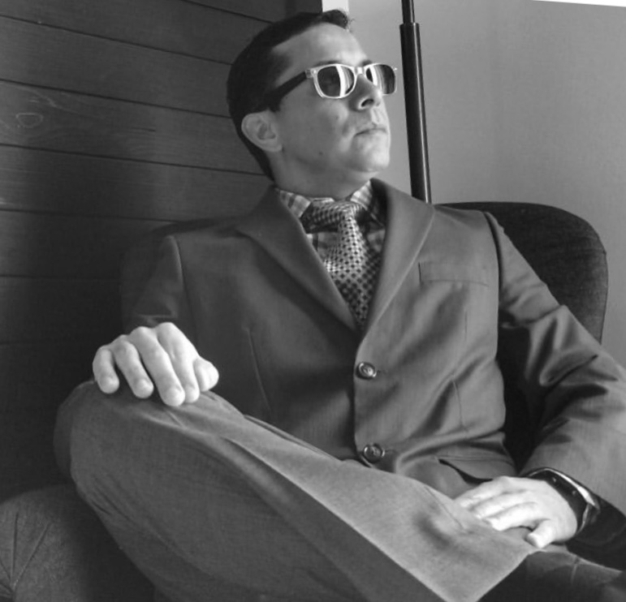
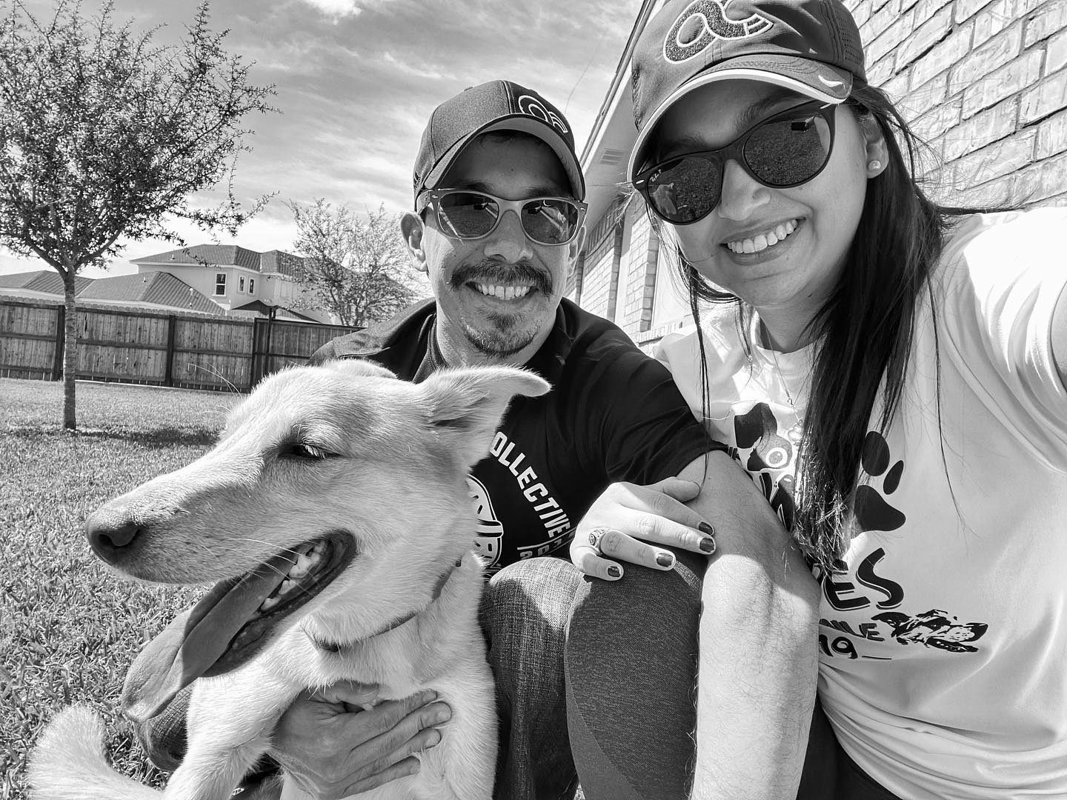


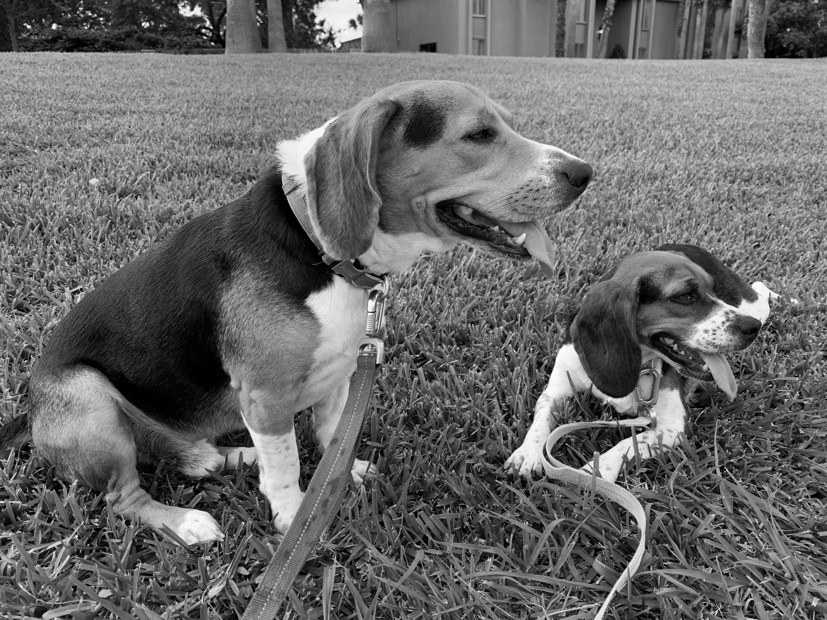
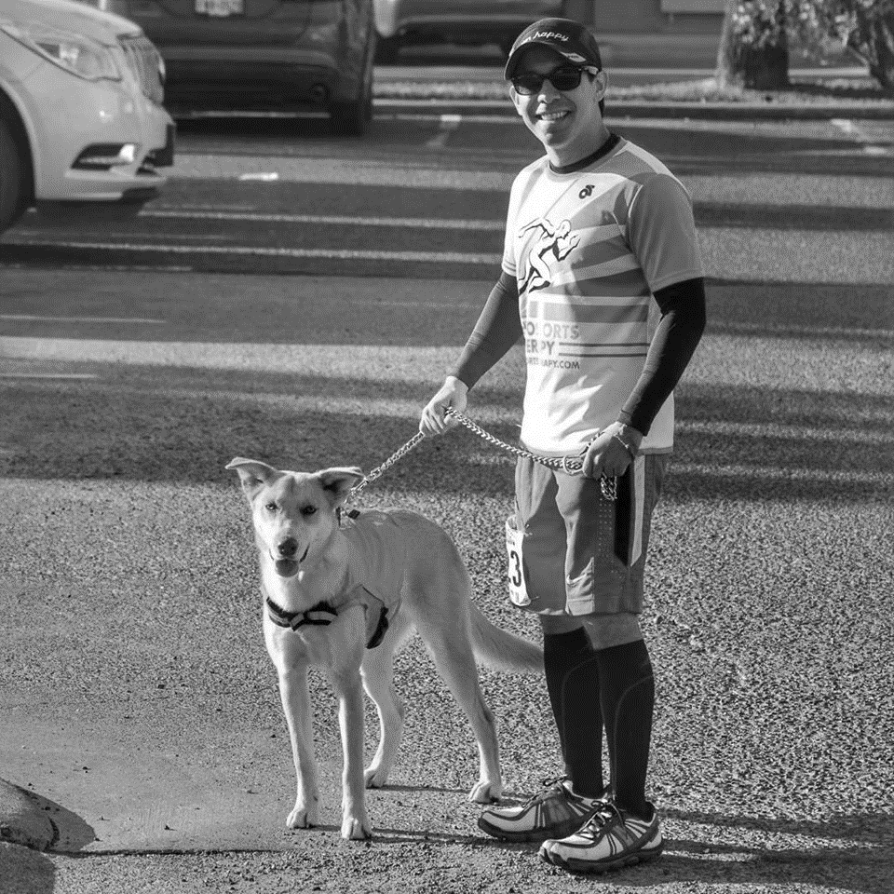









Welcome to ENGR 102!
Professor of Practice
-While in industry, I was primarily responsible for new product development with alternative fuels (at the national laboratory) and notebook computers (at Dell).
-Responsibilities included finite element analysis, failure modes effects analysis, component/system redesign and cost reduction, quality control, and procurement. I have also managed product research and development teams delivering new products to market.
-Upon transitioning to academia, I have taught at the Junior High, High School, and College level over the span of 13 years.
SKY
KYLO & KYBER
In training for:

Slide 3
Syllabus review

Slide 4
Why I Am Here...Me...the Professor
What is a Professor of Practice? (not telling you about engineering but teach you engineering) https://engineering.tamu.edu/academics/professors-of-practice.html
Why the Engineering Academy?
Why Engineering? http://www.60x30tx.com/
Why Texas A&M University? https://www.tamu.edu/admissions/index.html#freshmen

Slide 5
Preparatory Course Content
ABET Student Outcomes
Grand Challenges
UN2030 Agenda
Career Prep

Slide 6
ABET Students outcome
Criterion 3. Student Outcomes
-The program must have documented student outcomes that support the program educational objectives. Attainment of these outcomes prepares graduates to enter the professional practice of engineering. Student outcomes are outcomes (1) through (7), plus any additional outcomes that may be articulated by the program.
-an ability to identify, formulate, and solve complex engineering problems by applying principles of engineering, science, and mathematics
-an ability to apply engineering design to produce solutions that meet specified needs with consideration of public health, safety, and welfare, as well as global, cultural, social, environmental, and economic factors
-an ability to communicate effectively with a range of audiences
-an ability to recognize ethical and professional responsibilities in engineering situations and make informed judgments, which must consider the impact of engineering solutions in global, economic, environmental, and societal contexts
-an ability to function effectively on a team whose members together provide leadership, create a collaborative and inclusive environment, establish goals, plan tasks, and meet objectives
-an ability to develop and conduct appropriate experimentation, analyze and interpret data, and use engineering judgment to draw conclusions
-an ability to acquire and apply new knowledge as needed, using appropriate learning strategies.
https://www.abet.org/accreditation/accreditation-criteria/criteria-for-accrediting-engineering-programs-2020-2021/

Slide 7
Grand Challenges for Engineering
http://www.engineeringchallenges.org/challenges.aspx

Slide 8
The United Nations 2030 Agenda
https://sdgs.un.org/

Slide 9
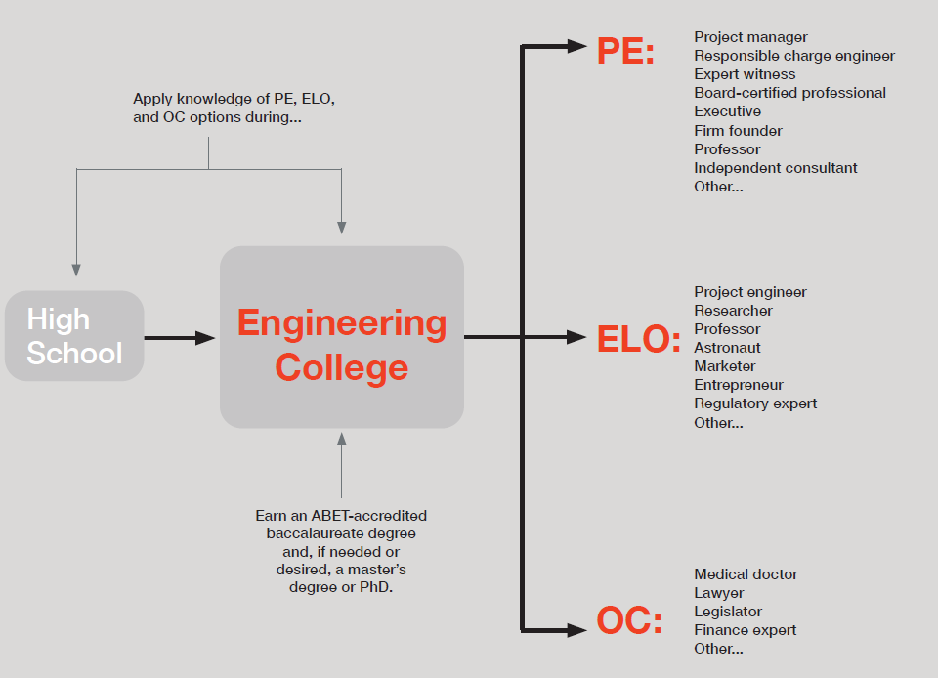
Engineering’s Three Career Options
Professional Engineer (PE)
Engineer with License Optional (ELO)
Other Career (OC)

Slide 10
The Engineering Profession
NSPE: https://www.nspe.org/resources/ethics/code-ethics/engineers-creed
NCEES: Welcome to NCEES
TBPE&LS: https://pels.texas.gov/
Project Management Institute | PMI

Slide 11
Engineers, in the fulfillment of their professional duties, shall:
Hold paramount the safety, health, and welfare of the public.

Slide 12
Time Management Guidance
Build a calendar and slot times such that you treat every event or action as a meeting to schedule.
Experiment with calendars to find a “best fit”, quickly.
ENGR 102 has a solid weekly flow...engage.
Teamwork is paramount. Everyone should contribute.

Slide 13
Classroom Environment
A driver of your time management plan is being aware of your physical, social, emotional, and mental health.
Engage with your peers and strive to ensure that no one feels alone. You are going through the challenges ahead together, as a team.

Slide 14
What is Computational Thinking?
Decomposition - Breakdown complexity into smaller parts.
Pattern Recognition - Explore parts for similarities.
Abstraction - Focus on important, ignore irrelevant.
Algorithms - Construct step-by-step solution.

Slide 15
ENGR 102 Course Detail
Internalizing the programming process
Using the Python language

Slide 16
How this class works
ENGR 102 is a 2-credit class:
1 hour per week of “lecture” (1 credit)
3 hours per week of “lab” (1 credit)
So, we meet 4 hours per week
About 1 hour each week will be instructor-driven
About 3 hours each week will be hands-on work (programming, team work, quizzes/exams)
Attendance is required (except when sick)
Quizzes and exams during meeting times
Lab work may involve working in teams
Attendance will affect lab grade
Please do not come to class if you are not feeling well!
Notes:
TAMU encourages students to get vaccinated and wear a mask, but we CANNOT require it

Slide 17
Your Time Expectations (outside class)
For every credit hour, you should expect to spend 2-3 hours outside of class on the subject, weekly
So, for ENGR 102, you should expect to spend 4-6 hours a week, beyond the time spent in class
You should expect to spend time on:
College of Engineering Homework – based on online video modules (0.5 hours/week)
Reading (Zybook) (up to 1 hour/week)
Lab assignments (3-5 hours/week)
Studying (regularly, but exam study time will be given in lieu of lab assignments)

Slide 18
Weekly ENGR 102 Course Flow
Zybook activities completed by Tuesday night of that week
Weekly exploration of Featured Departments and Engineering Modules due Friday night of that week
Individual Lab due by Monday night the following week
Team Lab due Tuesday night the following week

Slide 19
Zybook Introduction (Please hold off purchase until I confirm class code)
Interactive, digital textbook.
Tailored to match flow of the course.
Combine with lecture review to prepare for each week.
Instructor pulls completion metrics from Zybook tracker.

Slide 20
Lecture 1
Introduction to course, Welcome to Engineering, What is Programming and Why is this the first thing being covered in Engineering?

Slide 21
Why Are We Studying Programming?
Computer programs are a fundamental tool across all of engineering
Computing is transforming all of engineering (and every other field)
For some of you, computing will be the central focus of your study
Computer programming is an element of engineering on its own
Involves designing and building a solution to solve some problem, or enable something new to be done
Producing software is similar to building other things
Involves design, analysis, construction, testing, etc.
The “material” used to build with is computer code
Not all engineering involves physical devices
Some fields focus on processes, for instance!

Slide 22
Recent Survey
In a recent survey of Texas A&M Engineering graduates, asking them what their job involved, Computing was listed more frequently than every other topic!
As we prepare you for being engineering leaders for the next decades, computing skills will be a critical component of your skill set

Slide 23
ENGR 102 and the Common Curriculum
In 2017, faculty representatives from several departments met to discuss how the common Engineering curriculum should be updated
The committee discussed what topics were important enough that all Engineering students should have them, and what order those topics should be encountered
The result of this meeting was that a programming course should be the first course for Engineering students
ENGR 102 was created to meet this goal

Slide 24
Programming

Slide 25

Computer Programming – The Basic Process
A programmer writes commands / instructions, called a program, for the computer to follow
A compiler or interpreter takes those commands and converts them to instructions that the computer can understand
When a program is run, the instructions are executed on the computer
010100101001010100101110101010111010101010111101001010001010100010111…
command
command
command…
command
Computer Program
Machine Instructions

Slide 26
The Program
A program is just a text file with computer commands in it
You can, generally, use any editor you want to write a program
Saving as a text file, with the right extension: .py for python, for instance
Some editors are designed to help write programs
Can color-code text, give hints, autofill, etc.
Often, an editor is tied together with a compiler and other features into an Integrated Development Environment (IDE)
We will be using an IDE for this course (Spyder)
Notes:
Feel free to use PyCharm (or whatever you prefer) instead of Spyder

Slide 27
Compiler/Interpreter
The compiler or interpreter translates the program into machine instructions
Think of a compiler as pulling all the information in the program together, then generating machine instructions
Since it can look at the whole program, it can possibly create more optimal machine instructions
The machine instructions are typically saved to a file
Think of an interpreter as translating line by line
Often, the execution happens as it is interpreted, so there is no intermediate file saved
Python is usually thought of as interpreted

Slide 28
Execution
For a compiled program, the execution involves “running” the program
Most applications and programs you would run are compiled programs, ready to be executed
For an interpreted program, execution often happens right as the program is interpreted
So, the “program” that is run is just the original program – the machine instructions might not be saved to a separate file
Sometimes, the original program is called a “script”
With an IDE, the execution often takes place in a window or part of the IDE itself

Slide 29
Programming Languages
The computer processor understands commands in binary
It is incredibly painful for people to write significant amounts of code in binary
Assembly language provides a direct mapping between the binary commands and something a person can read
Essentially, it just translates from binary to a text representation
It is still difficult to write significant amounts of code in this form
Programming languages have been developed to help people understand the instructions given to a computer
Although they are still commands to the computer, they are conceptually easier to understand
It is usually much easier to comprehend the ideas/purpose of a program in a programming language
It is usually more efficient: one statement in a programming language can replace many assembly/machine instructions

Slide 30
Programming Languages
Many languages have been developed
Each has its own benefits and drawbacks
They have increased and decreased in popularity over time
There is no “best” language, though some languages are better than others for particular tasks
Python
Ruby
Java
C#
C++
Ada
COBOL
PHP
Fortran
Lisp
Basic
R
Perl
Scheme
Matlab
Pascal
Javascript
Haskell
Prolog
C
Scheme
ML

Slide 31
Why Python?
Our main focus in this class will be on Python programming
Python is generally considered
Easy to learn
Powerful (real applications are written with it)
Flexible (can be used for many different applications – lots of library support)
Popular (it is being used more and more)
Random note: Python gets its name from Monty Python, the British comedy troupe!

Slide 32
Python and Math courses
If you are taking MATH 151, you will probably see some Python
Unfortunately, MATH wants to solve equations analytically, so it will use SymPy – something utterly useless to us
Ideally, you will gain experience in Python in both courses
Keep in mind that the topics we cover also have equivalents in many other languages
Learning a new programming language after knowing one is much easier

Slide 33
Getting Set Up
In the lab portion, you will work on getting the environment set up, and writing your first programs
What you’ll need for our class:
A Python interpreter (Python – Anaconda Distribution)
A Python IDE (Spyder or PyCharm)
We will be using the IDE to develop our programs, compile them, and execute them
But, if you just save your ~.py files on your computer, and have the Python interpreter installed, you can execute them directly

Slide 34
Your First Program
We will develop more advanced programs as the course goes on, but will start out with some basic ones
The traditional first program people write is called “Hello, World”
We’re going to Aggie-fy it!
We can do this with one line of code:
print("Howdy, World!")

Slide 35
The print statement
Program
print("Howdy, World!")
print(1)
Output
Howdy, World!
1
The print command instructs the computer to print whatever is in the parentheses to the screen
For text, the text to print should be in quotation marks, single '' or double ""
Numerical values can be placed directly inside

Slide 36
Printing
Each print statement will print one value on one line
We can put multiple print statements into one program
We’ll see more about how to use print statements later in the course
But, feel free to experiment, or learn on your own!
Note: “print” is a generic term for “display” (usually to the screen), in contexts like this. It does not mean “print on paper using a printer.”

Slide 37
Mathematical Calculations
Mathematical computations are one of the most common things we’ll do in this class
And are a core part of almost all computer programs
Python has support for the basic arithmetic operations
+ Addition
- Subtraction
* Multiplication
/ Division
Order of operations is enforced
So, 2 + 3 * 4 = 14
Parentheses are also enforced
So, (2 + 3) * 4 = 20
Notes:
PEMDAS

Slide 38
More Mathematical operations (built in)
Power: **
2 ** 10 = 1024
Integer Division (division without remainder): //
7 // 3 = 2
Modulus (remainder from division): %
7 % 3 = 1
100 % 10 = 0

Slide 39
More mathematical functions
We will add one line to our programs to give us access to additional mathematical functions
We’ll see exactly what this is doing later on
For now, put the following line at the top of your program:
from math import *
Mathematical functions will have a name and parentheses that enclose the value to take the function of
e.g. cos(0) is the cosine of 0

Slide 40
Common mathematical functions
Remember to start program with: from math import *
sqrt(x) square root of x
cos(x), sin(x), tan(x) trigonometric functions
acos(x), asin(x), atan(x) inverse trigonometric fucntions
log(x), log10(x) logarithm, base e (natural) or base 10
exp(x) or e**x (e is the base for a natural logarithm)
There are many more…
Note: trig functions use radians, not degrees

Slide 41
What would the following program print?
from math import *
print("ENGR")
print(((3 ** 3) + 4 * 5) * (sqrt(25) // 2) + (28 % 10))
Output:
ENGR
102.0

Slide 42
Why?
((3 ** 3) + 4 * 5) * (sqrt(25) // 2) + (28 % 10)
(( 27 ) + 20 ) * ( 5 // 2) + ( 8 )
( 47 ) * ( 2 ) + ( 8 )
( 94 ) + ( 8 )
102
Why is 102.0 printed instead of 102?
We’ll see in 2 weeks!

Slide 43
A comment about comments
Code can also include “comments”
These start with a # character
Everything on the line after the # is ignored by the computer
Comments are there to help users
We’ll come back to these in more detail, later
For now, we will use comments to write information at the top of our program, for class purposes
To record your name, etc

Slide 44
First week’s activities/goals
Install the Python Compiler
Install the IDE
Write your first “Howdy, World!” program
Practice computing mathematical values

Slide 45
Python Supports
Google colabs - Python
W3schools - Python
Udacity MOOC - Python Intro
Linkedin learning - Python with Marini
Python.org
Pythontutor.com
Code academy - Learn Python3

Slide 46
More Supports
Replit web-based IDE
Python course tutorial
Python Institute tutorials and certifications
Python Example Codes
Texas A&M Engineering IT software load (ana/py)
PhET - Physics simulation from U. of Colorado-Boulder
TinkerCad by Autodesk
HyperPhysics - physics concept visualization

Slide 47
College Supports & Info
Academic Success Center - Tutoring
Supplemental Instruction (SI) Sessions
Bring Your Own Device (BYOD) Support
Texas A&M IT Help Desk (Howdy/Canvas/Systems)
Lumen Learning - Freshman Experience
Mathisfun - Derivatives
NAE Engineering Grand Challenges
Fightin’ Texas Aggie Band Performance Videos

Slide 48
Fun and Intriguing
Aggie Traditions
Snarky Puppy Quarter Master - Jazz Improv
Boston Dynamics Youtube Page
Corning: Day of Glass
Texas A&M College of Engineering
The Moonshot Factory
MIT
Texas A&M Engineering News Feed

Slide 49
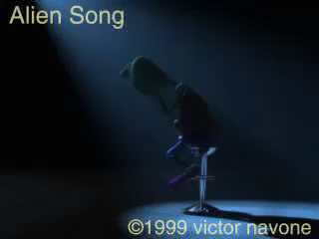

Slide 50

YOU CAN DO IT!!!
Remember, we are all in this together!
Please work together and help each other be successful!
Please develop a weekly study plan and stick to it!
Please note deadlines and hold yourself/team accountable!
Communicate, communicate, communicate!

Slide 51
Lecture 1 – Supplementary Slides
Introduction to course, Welcome to Engineering, What is Programming and Why is this the first thing being covered in Engineering?

Slide 52
Coding Environment (Pycharm)
If you have loaded Anaconda and PyCharm successfully, you are welcome to use PyCharm for your practice activities.
Open PyCharm (It may take a little while to open and configure) then select File and New Project. Name the project and note the folder configuration.
Select File again, then New, then Python file.
Name the file and you are good to go.

Slide 53
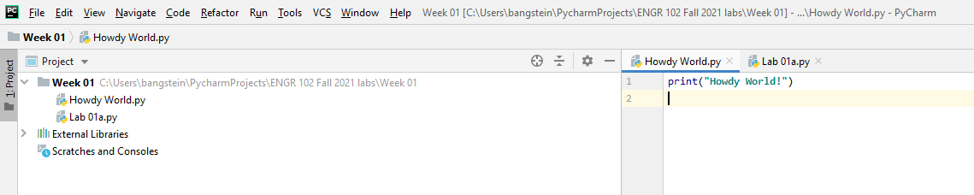
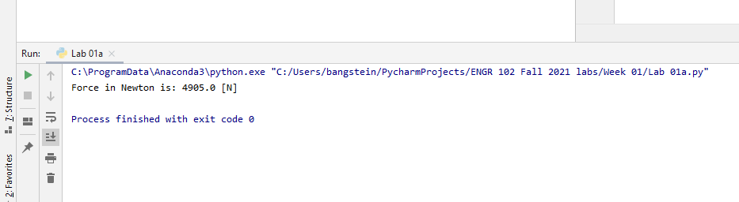
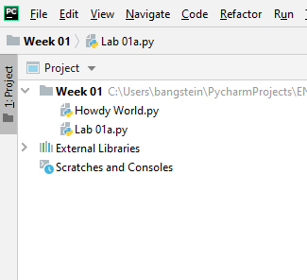
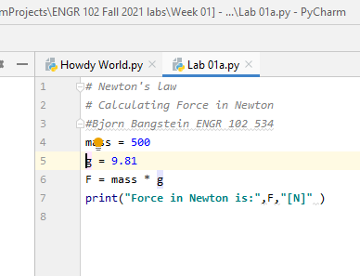



Start a new Python project and files

Slide 54
Print commands
The ‘print()’ command is used to send output to the display.
Each print statement will print one value on one line.
There can be multiple print statements in a program.
The print command is designed to provide output from the program, yet also functions as a very valuable troubleshooting tool.

Slide 55
Print commands
print (‘Howdy, World!”) will create a display of the following:
Howdy, World!
Work with this command a bit in a Python space.
Try print(2+2) and print(‘2+2’)...what do you observe?

Slide 56
Mathematical Operatives
Python basic arithmetic operations:
Addition (+) and Subtraction (-)
Multiplication (*) and Division (/)
Power (**)
Integer Division (division without remainder) (//)
7//3 = 2
Modulus (remainder from division) (%)
7%3 = 1 or 100%10 = 0

Slide 57
Variables
Variables are names that we give to places in computer memory where we will store data with our programs.
Names can start with a letter (lowercase or uppercase) or an underscore (_).
The name can contain letters (lowercase or uppercase), numbers, and underscore characters.
The name cannot be a reserved keyword such as “for” and “while”. You will learn these as we progress.

Slide 58
Variable Data Types
Integers - Numbers with no decimals or fractions.
Floating-Point Numbers - Numbers represented using decimal points
Booleans - Logic choices such as True/False/And/Or/Not.
Strings - A way for storing text such as quote=”Gig’em Aggies!”.
Note that the equals sign(=) in Python means to assign. Double equal signs (==) means equality.

Slide 59
Write a code that calculate the kinetic energy for a given mass and velocity
Kinetic energy is directly proportional to the mass of the object and to the square of its velocity: K.E. = 1/2 m v².

Slide 60
Variable Practice
Now dig back through the following three slides and use the guidelines to explore what you can do with Python:
Mathematical Operatives
Variables
Variable Types
Take 15 minutes to work with these in breakout rooms and share your findings with your breakout team peers.

Slide 61
Variable Practice
Enter the following in your Python session, then run:
Aggie=2025
QuarterCentury=25
print(Aggie+QuarterCentury)
print(Aggie/QuarterCentury)
What is different about the output formats (data types)?

Slide 62
Debugging Code
If the code doesn’t work, deconstruct back to code that works, and then rebuild.
Methodically hide (remove) code until you find what is not working as expected. Adjust, then methodically unhide.

Slide 63
Conditional/Boolean Detail
The result of a relational operator is a Boolean value. (True/False)
Equality: == [note the two equal signs, instead of one. One is “assignment”!]
Inequality: != [note the !]
Less Than: <
Greater Than: >
Less Than or Equal To: <= [note that =< is not allowed] Greater Than or Equal To: >= [note that => is not allowed]

Slide 64
Conditional/Boolean Detail
The Boolean operators are and, or, and not.
A and B : true if both A and B are true, false otherwise.
A or B : true if A is true or B is true (or both are true), false otherwise.
not A : “reverses” A, so true if A is false, false if A is true.
In numerical terms, 0/Null/Empty == False,
Anything else == True.
If/elif/else handle non-loop conditions

Slide 65
Conditional/Boolean Practice
Why this output for the following program?
a=5
b=6
c=b<a
print(c)
d=b>a
print(d)

Slide 66
Conditional/Boolean Practice
Why this output for the following program?
a=5
b=6
c=b<a
print(c)
d=b>a
print(d)
Output:
False
True

Slide 67
Loop Detail
Loop Drivers:
for - When you know, or can calculate the iterations.
while - When iterations are unknown.
Program continues performing indented operations and loop back up until conditions are met.
Often counters are in play to track loop count.
‘While true:’ is often used for a continuous loop.

Slide 68
Loop Practice
Eggs = 0
while Eggs < 12:
Eggs = Eggs + 1
print(‘A dozen eggs, next’)
How can we count out a dozen dozen?

Slide 69
Loop Practice (using while)
Eggs = 0
Dozen = 0
while Dozen < 12:
while Eggs < 12:
Eggs = Eggs + 1
Dozen = Dozen + 1
print(‘Another dozen (‘ + str(Dozen) + ‘) eggs, next’)
print(‘Behold, a gross of eggs!’)

Slide 70
Loop Practice (using for)
Eggs = 0
Dozen = 0
for i in range(12):
for j in range(12):
Eggs = Eggs + 1
Dozen = Dozen + 1
print(‘Another dozen (‘ + str(Dozen) + ‘) eggs, next’)
print(‘Behold, a gross of eggs!’)

Slide 71
Code Structures
Use space to support clarity of code. Blocking is an effective method for keeping actions organized.
Always include comments above blocks and right of lines of code for both you and those peers/employees that may be assigned to complete or adjust your code later.

Slide 72
Metacognition
College courses have many reflective activities, where you look back and think about what and how you learned.
You will encounter many cross-curricular activities across engineering, math, and physics. Strive to make the connections across disciplines. ETAM essays and lab reports will also pull from your writing courses.
If you cannot communicate an idea or finding effectively, it will appear like the idea or finding did not occur.

Slide 73
Career Prep
Begin working on your ‘elevator pitch’ of your vision and passion now.
Also begin revising your resume. The design you used to get you into college may be very different from the one that gets you that internship, which is an important next step.
Career fair in mid-January, be ready.
Take some time in breakout rooms to discuss visions and passions, and how you might communicate them succinctly.

Slide 74
To Recap from our Start
You have cleared a massive hurdle just to be here now.
You will learn much about being an Aggie and being connected to the Aggie network.
You are a cohort with many team activities ahead. Strive to learn while also helping your peers progress.

